Slide 1

Objectives
In this session, you will learn to:
  Describe the Abstract Window Toolkit (AWT) package and its components
  Define the terms containers, components, and layout managers, and describe how they work together to build a GUI
  Use the Frame and Panel containers appropriately
  Add components to a container
  Use various layout managers to achieve a desired dynamic layout

Slide 2
Abstract Window Toolkit
Provides GUI components that are used in all Java applets and applications.
Contains classes that can be composed or extended.
Ensures that every GUI component that is displayed on the screen is a subclass of class Component or MenuComponent.
Has Container, which is an abstract subclass of Component and includes two subclasses:
  Panel
  Window

Slide 3
The java.awt Package
Basic overview of AWT package:
BorderLayout
FlowLayout
CardLayout
CheckboxGroup
Event
Color
Font
Graphics
MenuComponent
GridLayout
GridBagLayout
Image
Rectangle
Component
Java.lang.object
MenuBar
MenuItem
Menu
CheckboxMenuItem
Applet
Button
Canvas
Container
Label
List
TextComponent
Panel
Window
ScrollPane
Dialog
Frame
TextArea
TextField

Slide 4
Containers
The two main types of containers are:
  Window
  Panel
A Window is a free floating window on the display.
A Panel is a container of GUI components that must exist in the context of some other container, such as a Window or Applet.
Add components with the add() method.

Slide 5
Components
Java programming language supports various components:
  Button
  Choice
  Label
  List
  Scrollbar
  TextComponent, etc.
The position and size of a component in a container is determined by a layout manager.
You must use setLocation(), setSize(), or setBounds() on components to locate them in the container.

Slide 6
Frames
Frames have the following characteristics:
  Are a subclass of Window
  Have title and resizing corners
  Are invisible initially; use setVisible(true) to expose the frame
  Have BorderLayout as the default layout manager
  Use the setLayout() method to change the default layout manager

Slide 7
Frames (Contd.)
An example to create a frame:
  import java.awt.*;
  public class FrameExample {
  private Frame f;
  public FrameExample() {
    f = new Frame("Hello Out There!");}
  public void launchFrame() {
    f.setSize(170,170);
    f.setBackground(Color.blue);
    f.setVisible(true); }
  public static void main(String args[]) {
    FrameExample guiWindow = new FrameExample();
    guiWindow.launchFrame(); }
  }
Declaration of Frame Object
Initialization of Frame Object
Setting the size of Frame
Making Frame visible

Slide 8
Panels
Panel provide a space for components.
This enables subpanels to have their own layout manager.
After creating Panel, it must be added to a Window or Frame.

Slide 9
Panels (Contd.)
The following code snippet helps in creating a small yellow panel and adds it to a frame:
  public Panel pan;
  public Frame f;
  f=new Frame( “I’m with panel”);
  pan = new Panel();
  public void launchFrame()
  {
  f.setSize(200,200);
  f.setLayout(null); // Use default layout
  pan.setSize(100,100);
  pan.setBackground(Color.yellow);
  f.add(pan);
  f.setVisible(true);
  }
Declaring Panel Object
Initializing Panel Object
Setting the size of Panel
Giving the yellow color to the Panel
Adding Panel to the Frame

Slide 10
Layout Managers
Layout managers are used to place the components on required positions.
The following layout managers are included with the Java programming language:
  FlowLayout
  BorderLayout
  GridLayout
  CardLayout
  GridBagLayout

Slide 11
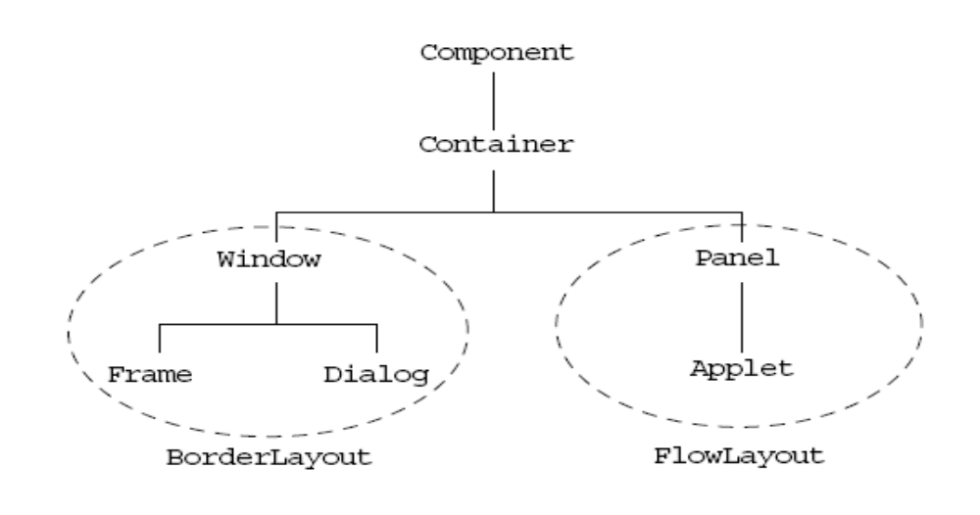
Layout Managers (Contd.)
The Default layout manager for Window, Frame, and Dialog class is BorderLayout.
In the same way for Panel and Applet, FlowLayout is default layout manager.

Slide 12
Layout Managers (Contd.)
The FlowLayout manager has the following characteristics:
  Forms the default layout for the Panel class
  Adds components from left to right
  Alignment default is centered
  Uses components preferred sizes
  Uses the constructor to tune behavior

Slide 13
Layout Managers (Contd.)
A simple example of FlowLayout:
  public class LayoutExample
  {
  private Frame f;
  private Button b1;
  private Button b2;
  public LayoutExample()
  {
  f = new Frame("GUI example");
  b1 = new Button("Press Me");
  b2 = new Button("Don’t press Me");
  }
Declaring the components
Initializing the components

Slide 14
Layout Managers (Contd.)
  public void launchFrame()
  {
  f.setLayout(new FlowLayout());
  f.add(b1);
  f.add(b2);
  f.pack();
  f.setVisible(true);
  }
  public static void main(String args[])
  {
  LayoutExample guiWindow = new LayoutExample();
  guiWindow.launchFrame();
  }
  }
Setting FlowLayout
Adding components on the Frame

Slide 15
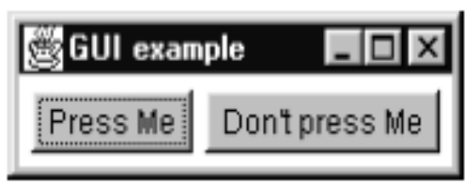
Layout Managers (Contd.)
The preceding code will show the following output:

Slide 16
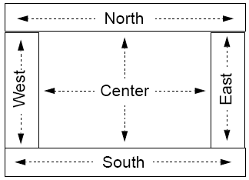
Layout Managers (Contd.)
The BorderLayout manager has following characteristics:
  Default layout for the Frame class
  Components are added to specific regions
  The resizing behavior is as follows:
    North, South, and Center regions adjust horizontally
    East, West, and Center regions adjust vertically

Slide 17
Layout Managers (Contd.)
  Using the constructor without any parameters constructs and installs a new BorderLayout with no gaps between the components:
  setLayout(new BorderLayout());
  BorderLayout constructor specifiying hgap and vgap can be used to indicate the gaps between components:
BorderLayout(int hgap,int vgap);
  Components must be added to the named regions in BorderLayout manager:
f.add(button1,BorderLayout.NORTH);

Slide 18
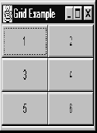
Layout Managers (Contd.)
The characteristics of GridLayout manager are:
  Components are added from left to right, and from top to bottom.
  All regions are sized equally.
  The constructor specifies the rows and columns. For example:
    f.setLayout ( new GridLayout( 3,2));
    This statement using in Java Program will help to get the following output:

Slide 19
Demonstration
Lets see how to create a Java class that uses the AWT API to create a simple GUI front end.

Slide 20
Drawing in AWT
Graphics class is an abstract class, which is used for drawing graphical figures.
Every component has a Graphics object.
The Graphics class implements many drawing methods.
You can draw in any Component (although AWT provides the Canvas and Panel classes just for this purpose).
Create a subclass of Canvas or Panel and override the paint() method.
The paint() method is called every time the component is shown (for example, if another window overlapped the component and was then removed).

Slide 21
Drawing in AWT (Contd.)
Example of paint() method:
  public void paint( Graphics g )
  {
  //display word "today" centred at x,y positions
  FontMetrics fm = getFontMetrics( g.getFont() );
  String wording = "today";
  int xadj = fm.stringWidth( wording ) / 2;
  //position bottom left corner of the text
  g.drawString( wording, x-xadj, y );
  //draw a red line from x1,y1 to x2,y2

Slide 22
Drawing in AWT (Contd.)
  g.setColor(Color.red );
  g.drawLine(x1, y1, x2, y2);
  //draw an pre-existing Image.imX, imY is top left corner of the Image.
  g.drawImage ( image,imX,imY,imWidth,imHeight,this);
  } // end paint

Slide 23
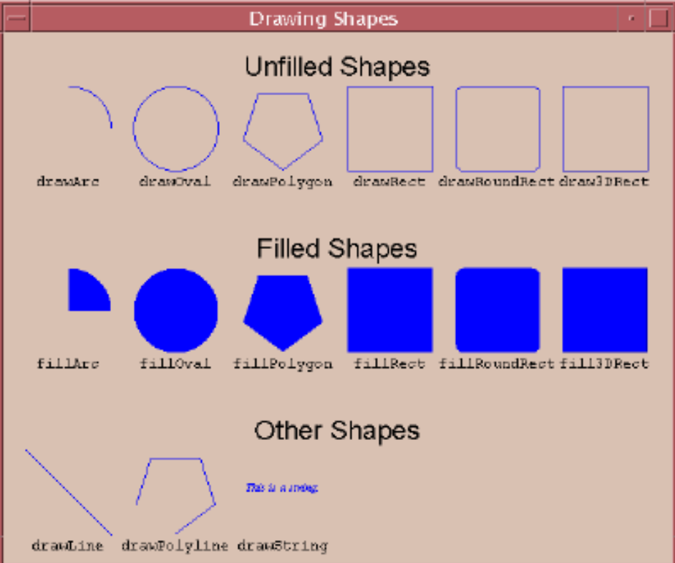
Drawing in AWT (Contd.)
Various Shapes Drawn by the Graphics Object:

Slide 24
Summary
In this session, you learned that:
  Abstract Window Toolkit provides GUI components that are used in all Java applets and applications.
  Window and Panel are subclasses of container.
  Button, Choice, Label, List, Scrollbar, TextComponent are various components supported by Java programming language.
  Frame is subclass of Window and they are invisible until setVisible(true)method is not used to expose them.
  Panel provides space for components and then panel need to be added to a Frame or Window.
  Layout Managers are provided by Java language to place the components at any required positions.

Slide 25
Summary (Contd.)
  Java programming Language supports following Layout Managers:
    FlowLayout
    BorderLayout
    GridLayout
    CardLayout
    GridBagLayout
  FlowLayout manager adds the components from left to right and it is default layout for Panel.
  BorderLayout manager adds the components to specific regions i.e North, South, East, West, and Centre.
  GridLayout manager adds components from left to right, and from top to bottom. The regions are sized equally as the specified number of rows and columns in the constructor.
  Graphical figures can be drawn by using Graphics class object.

